Slide 1
AOI32 - Static Logic
Group Number : 30
Group Members : 1.) Shivam Shukla - 2022478 2.) Vaibhav Singh - 2022555
3.) Satyam Pandey - 2022463
4.) Sujal Dagur - 2022512

Slide 2
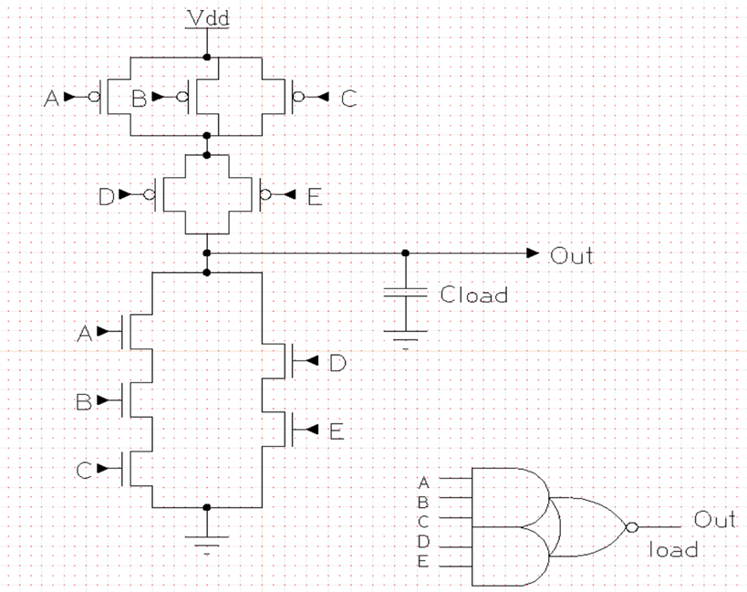
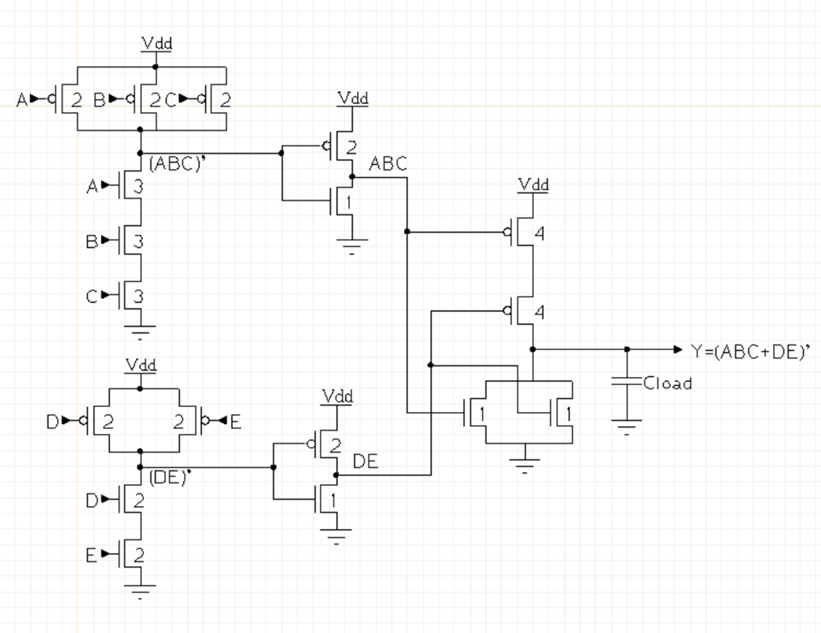
Schematic + Sizing
4
4
4
4
4
3
2
3
2
3
Complex Schematic
Sizing : U = 0.135um
4U = 4*0.135 = 0.540um
3U = 3*0.135 = 0.405um
2U = 2*0.135 = 0.270um
Non-Complex Schematic
OUT = ((A.B.C)+(D.E))​

Slide 3
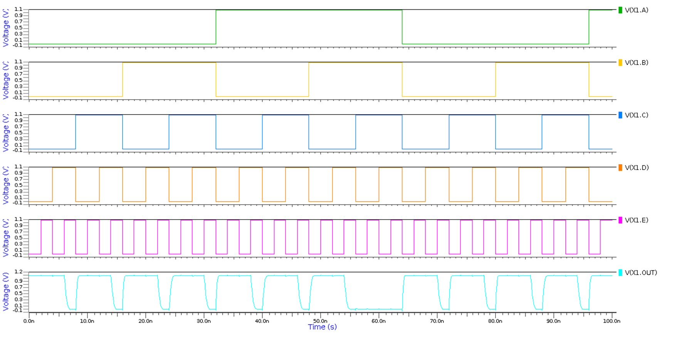
Output Waveform

Slide 4
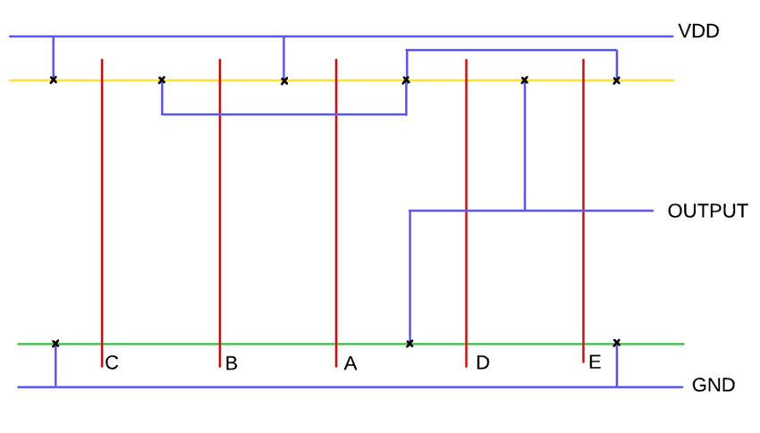
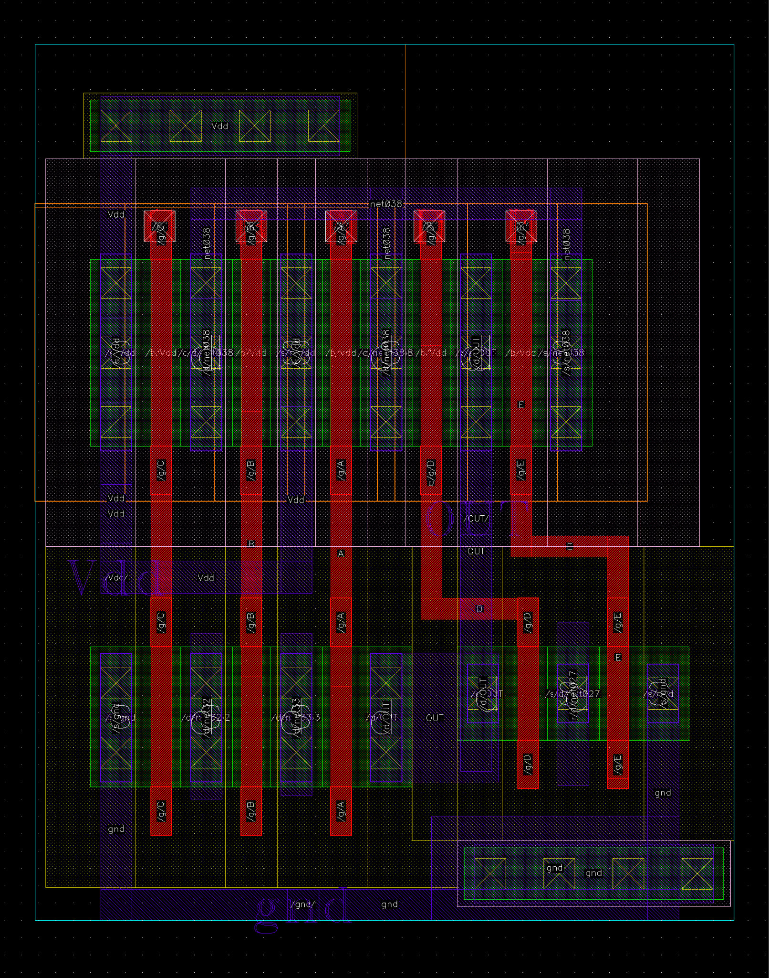
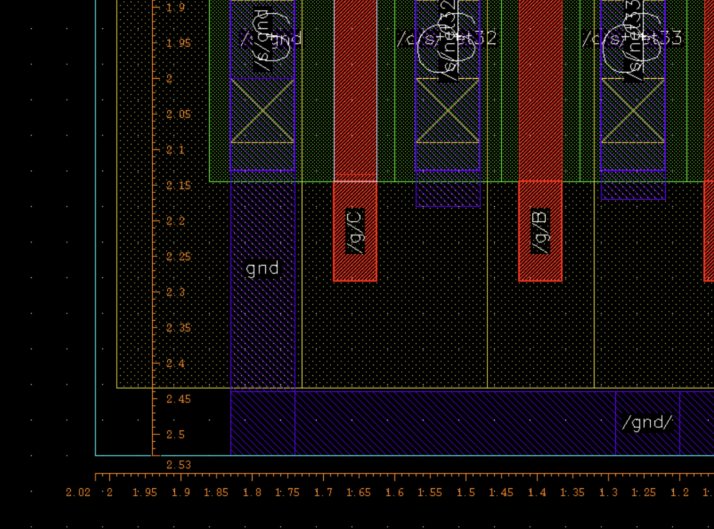
Stick Diagram + Layout (Complex)
Cell Dimensions
Area = 2.53um x 2.02um
= 5.1106 um^2
Length = 13 tracks
Breadth = 10 tracks

Slide 5
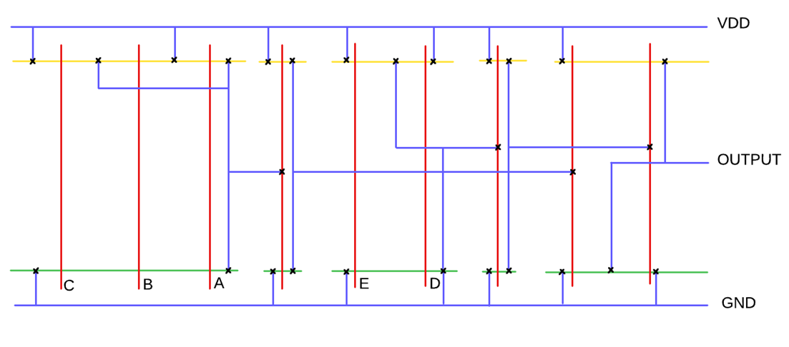
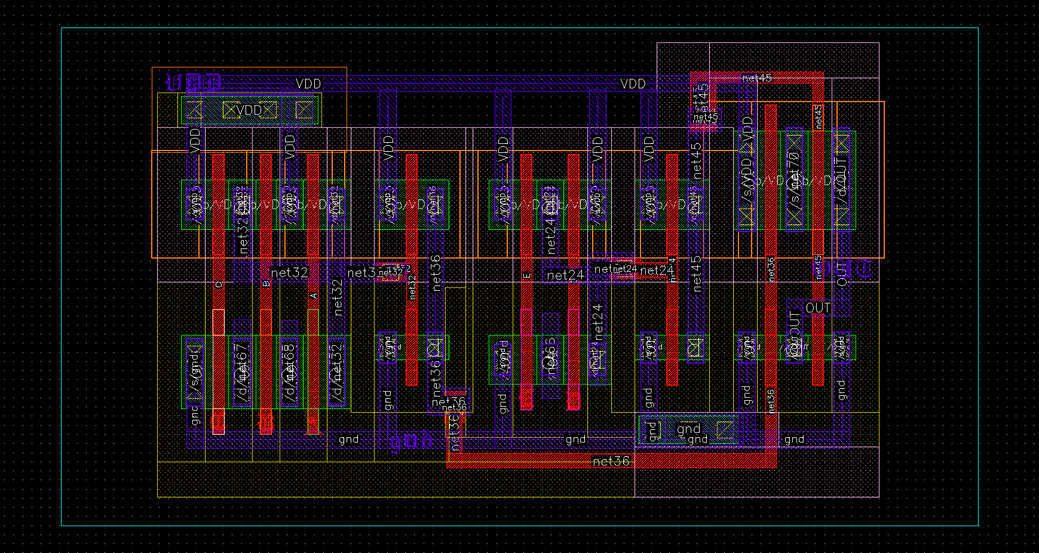
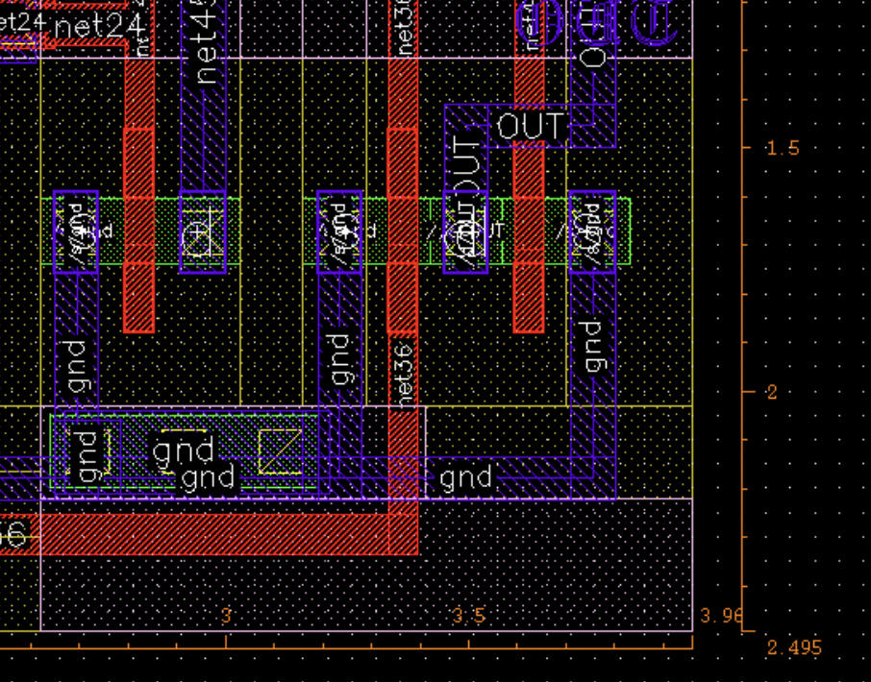
Stick Diagram + Layout (Non-Complex)
Cell Dimensions
Area = 2.49um x 3.96um
= 9.8604 um^2
Length = 13 tracks
Breadth = 20 tracks

Slide 6
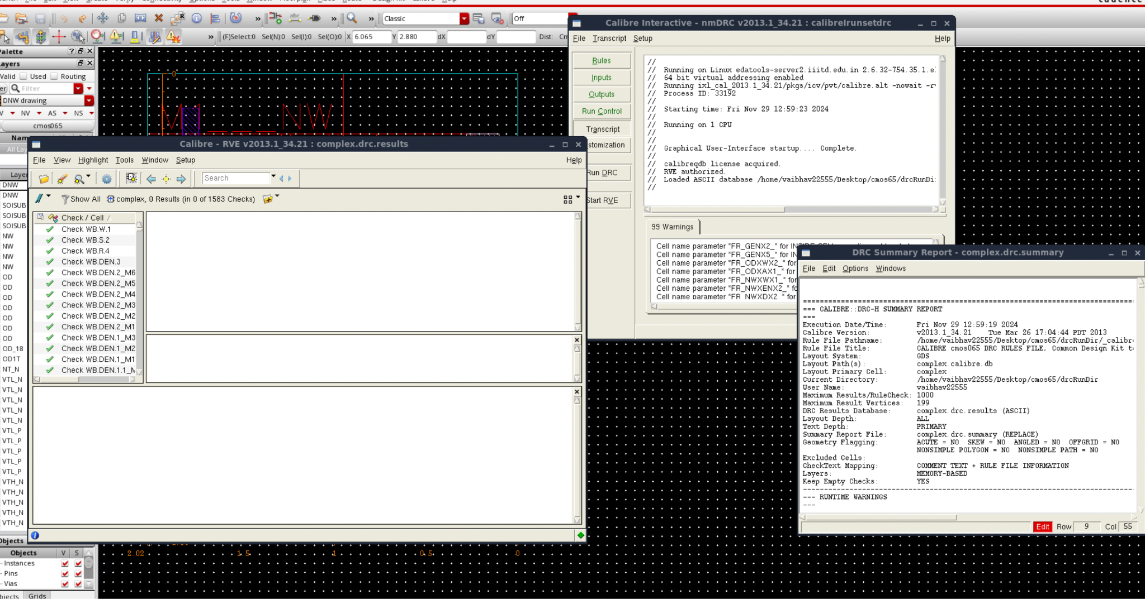
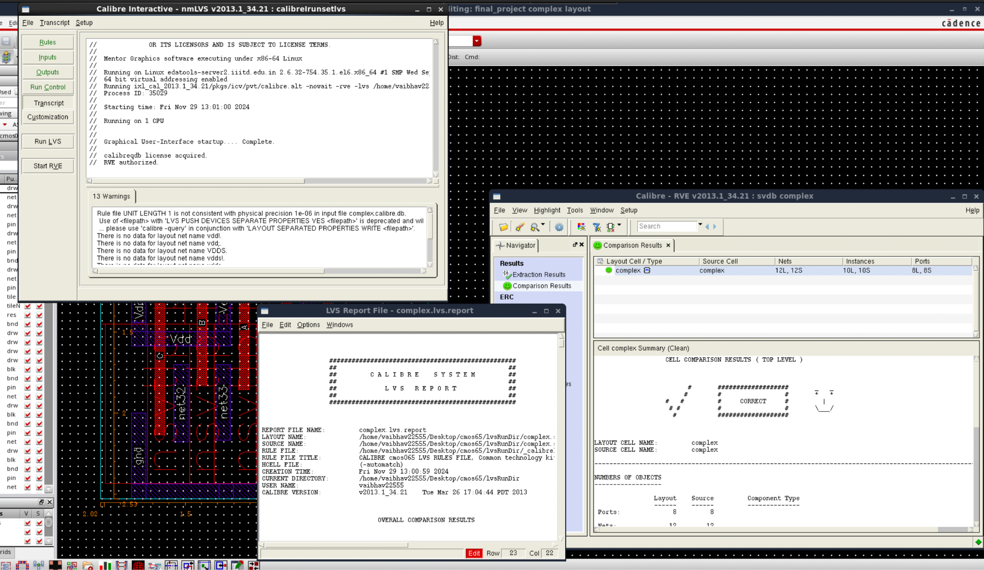
Verification (DRC+LVS) COMPLEX
DRC Clean
LVS Clean

Slide 7
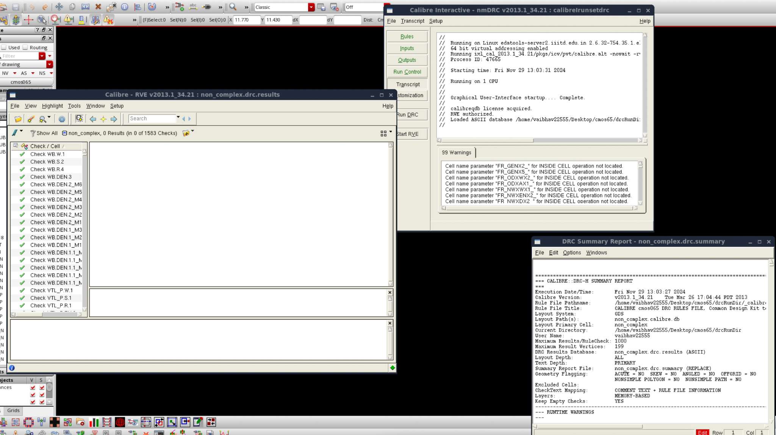
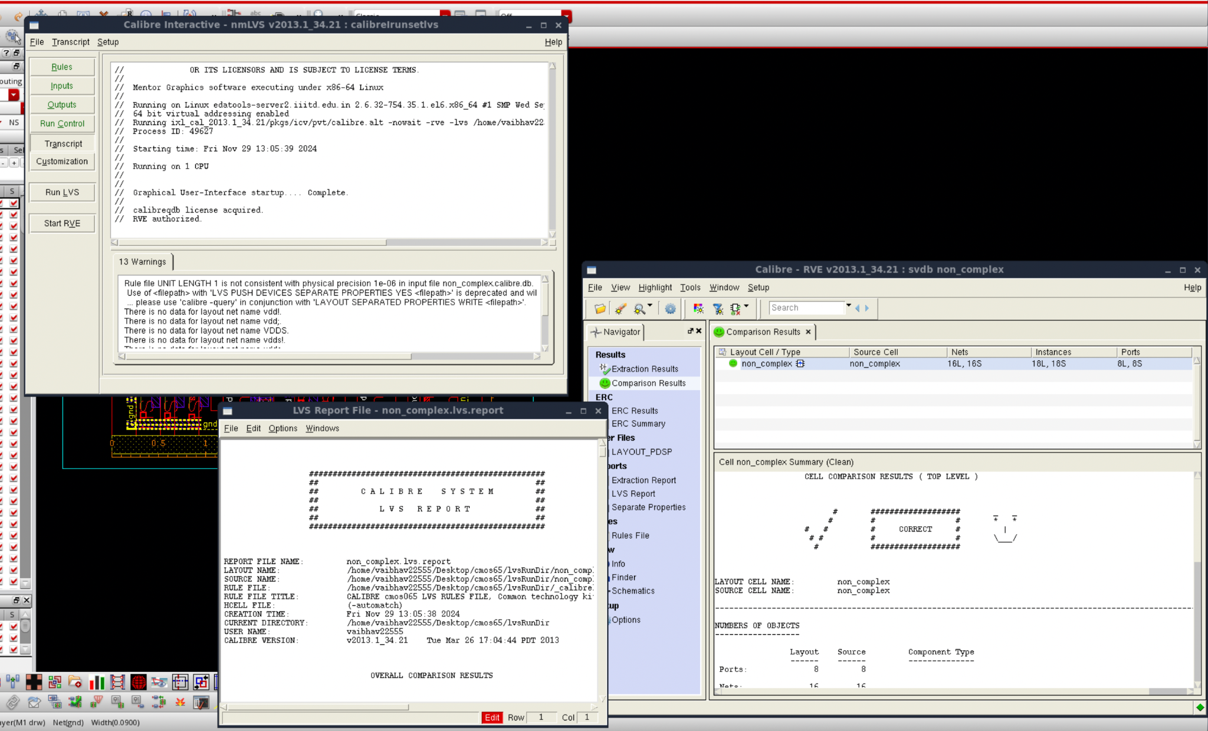
Verification (DRC+LVS) NON COMPLEX
DRC Clean
LVS Clean

Slide 8
Stimuli For Verification & Verification Plan
PVT Conditions
Best Case PVT | FF, 1.32V, -40C
Worst Case PVT | SS, 1.08V, 125C
Parameters | Rise Propagation Delay | Fall Propagation Delay | Rise Contamination Delay | Fall Contamination Delay
Input Stimulus | From: A=B=1,D=E=0 To: C (1 => 0) | From: A=B=D=E=0 To: C (0 => 1) | From: A=B=C=0 To: D (1=> 0), E (1=>0) | From: A=B=D=1 To: C (0 => 1),E(0=>1)

Slide 9
Pre and Post Layout Simulation Data
Condition
( SS, 1.08V, 125C )
( FF, 1.32V, -40C )
( TT, 1.2V, 25C )
Parameters
Complex | Non-Complex
Pre-Layout | Post-Layout | Pre-Layout | Post-Layout
Rise Propagation | 253.03 ps | 262.93 ps | 357.42 ps | 365.34 ps
Fall Propagation | 253.03 ps | 266.34 ps | 338.13 ps | 350.23 ps
Rise Contamination | 48.458 ps | 55.42 ps | 111.46 ps | 122.24 ps
Fall Contamination | 51.952 ps | 54.24 ps | 80.648 ps | 91.67 ps
Dynamic Power | 0.994 𝛍W | 1.427 𝛍W | 2.89 𝛍W | 3.49 𝛍W
Static Power | 3.73 𝛍W | 5.468 𝛍W | 8.45 𝛍W | 11.23 𝛍W

Slide 10
Work Distribution
Vaibhav Singh - Layout(DRC LVS) + Parasitic Extraction
Shivam Shukla - Schematic + Sizing + Stick Diagram + Waveform Analysis
Satyam Pandey - Stick Diagram + Parasitic Extraction
Sujal Dagar - Sizing + Parasitic Extraction

